Slide 1
Mutual Fund
Analytics
Presented by: Krithik S

Slide 2


Mutual Fund Analytics
Problem Statement & Objectives
Mutual fund data scattered across multiple datasets, hindering analysis.
Investors struggle to compare fund performance without dynamic tools.
Build an ETL pipeline, compute risk metrics, and analyze fund performance.
Develop interactive Power BI dashboards with fund recommendations.

Slide 3
Mutual Fund Analytics
Data Sources
Fund Master
NAV History
AUM by Fund House
Monthly SIP Inflows
Category Inflows
📁
📈
🏦
💹
📊

Slide 4
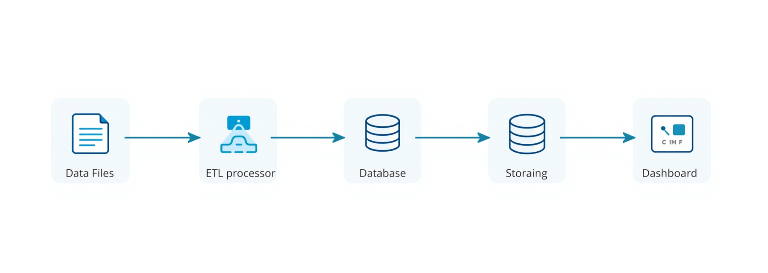
Mutual Fund Analytics
Project
Architecture
Data Ingestion
ETL Pipeline
Analytics Engine
Output Layer
Financial Metrics
→ SQLite DB
Power BI Dashboard
→ Business Insights
Raw CSV Files
Data Cleaning
→ Feature Eng.

Slide 5

Mutual Fund Analytics
EDA Highlights
Historical NAV Trend
Line chart showing long-term NAV growth across top mutual fund categories, revealing consistent upward trends over 5+ years.
Monthly SIP Growth
Bar chart illustrating month-over-month SIP inflow volumes, highlighting accelerating retail investor participation.
Industry AUM Growth
Area chart depicting cumulative Assets Under Management growth across fund houses, showing sector-wide expansion over time.
Category-wise Inflows
Stacked bar and pie charts breaking down fund inflows by category — Equity, Debt, Hybrid — to reveal investor allocation preferences.

Slide 6


Mutual Fund Analytics
EDA Insights
AUM Growth
SIP Dominance
Equity Inflows
NAV Trend
Assets Under Management show consistent year-over-year increase
SIP transactions dominate investor activity across all fund types
Equity funds attract the highest category-wise inflows consistently
Historical NAV data reveals stable long-term growth across top funds

Slide 7

Mutual Fund Analytics
Financial Performance Metrics
Daily Returns
CAGR
Sharpe Ratio
Alpha
Beta
0.12%
14.3%
1.82
+2.4%
0.76

Slide 8
Mutual Fund Analytics
Advanced
Analytics
Value at Risk
(VaR)
Conditional
VaR (CVaR)
Rolling 90-Day
Sharpe Ratio
Investor
Cohort Analysis
SIP
Continuation
Analysis
📉
⚠️
📈
👥
💹

Slide 9

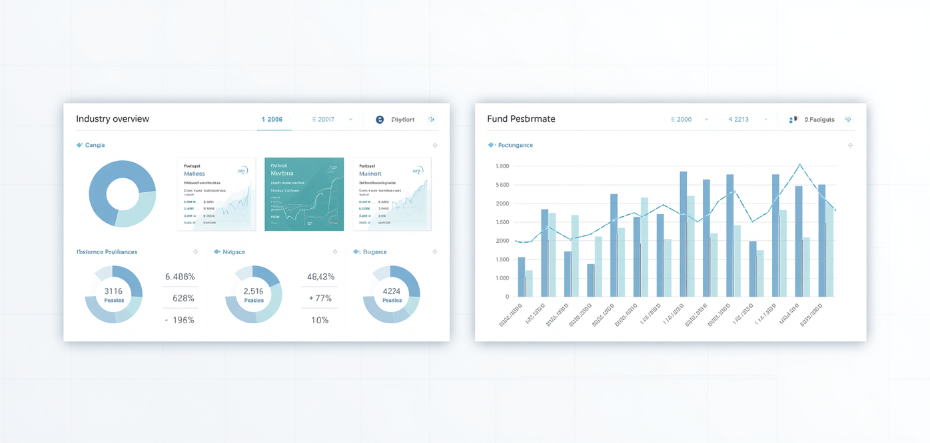
Mutual Fund Analytics
Dashboard Overview
Part 1
Industry Overview Dashboard
● Total AUM by fund category
● Fund house market share KPIs
● Sector-wise inflow filters & slicers
● Interactive tooltips for data details
● Dynamic trend visualizations
● Benchmark comparison overlays
Fund Performance Dashboard
● CAGR & Sharpe Ratio KPI cards
● NAV trend line chart visualizations
● Risk-return scatter plot with filters
● Fund score ranking with slicers
● Drill-through to fund-level detail
● Interactive tooltips & annotations

Slide 10
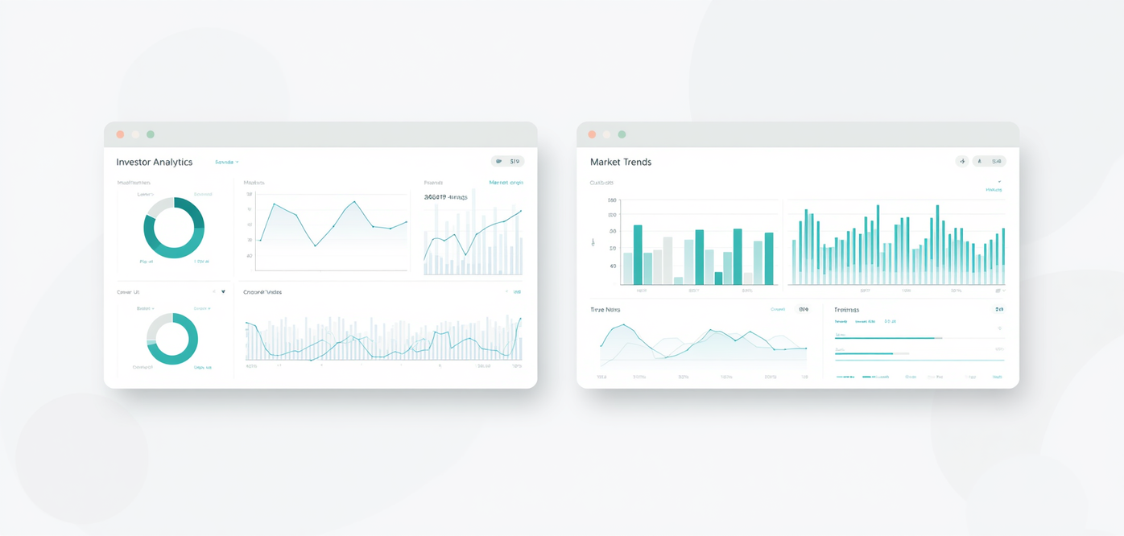
Mutual Fund Analytics
Dashboard Overview
Part 2
Investor Analytics Dashboard
• Drill-through capabilities for fund-level deep dives
• Dynamic slicers to filter by investor segment, region, and risk profile
• Cohort-based behavioral analysis views
• SIP continuation and redemption trend visuals
SIP & Market Trends Dashboard
• Benchmark comparison charts (fund vs. index)
• Interactive reports with cross-filtering visuals
• Monthly SIP inflow trend lines and growth metrics
• Category-wise and scheme-wise performance overlays

Slide 11
Mutual Fund Analytics
Key Findings
ETL Pipeline
Financial Metrics
Risk Analysis
Investor Insights
Dashboard Delivery
✓
✓
✓
✓
✓

Slide 12
Thank You!
Python | SQLite | Power BI

